Slide 1
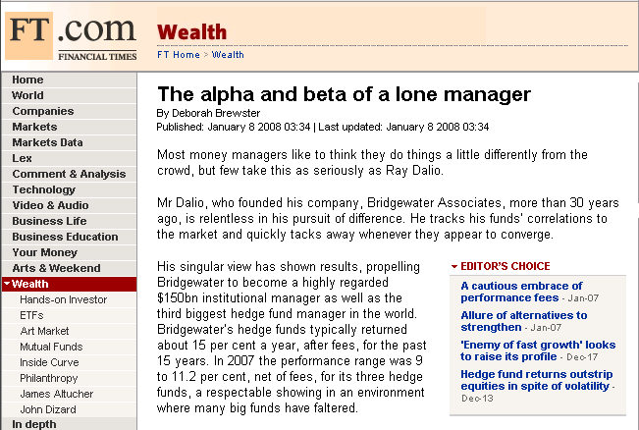
ON THE NEWS: Alpha and Beta of a stock
In Jan 2008, a Financial Times story attracted attention to a stock’s Alpha. How is a stock’s Alpha and Beta defined?

Slide 2
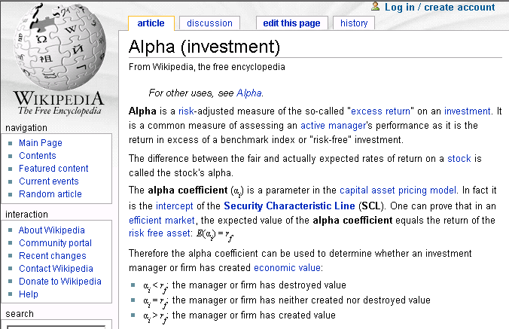
Definition of Alpha

Slide 3
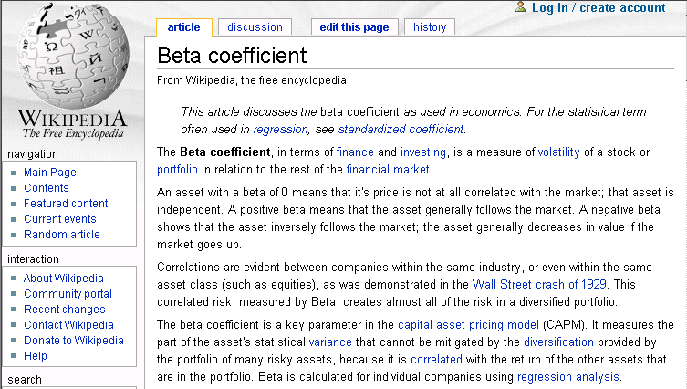
Definition of Beta

Slide 4

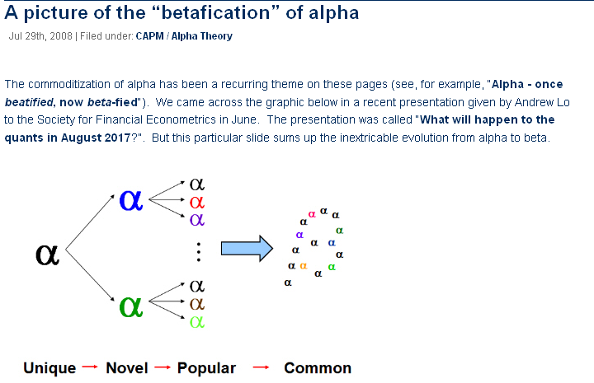
ON THE NEWS: The “Beta-fication” of Alpha?
In a presentation given to the Society for Financial Econometrics in July 2008, Andrew Lo argued that, as investors are presented with a variety of alpha options, alpha will slowly evolve to beta

Slide 5
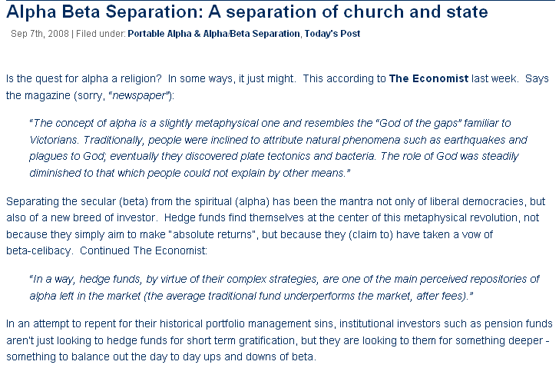
ON THE NEWS: Is the quest for Alpha a religion?
A Sep 2008, a story in The Economist argued that some people’s devotion to Alpha resembles a religion

Slide 6
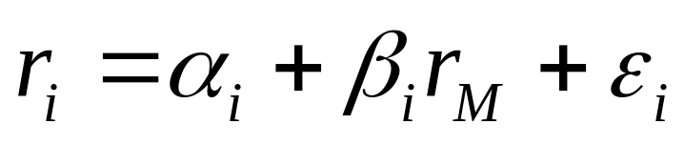
CAPM (Market Model)
The Capital Asset Pricing Model (CAPM), aka Market Model, decomposes returns of an individual security into two components: fixed and variable. For simplicity, let us consider monthly returns of security i in relation to monthly returns of a given market index M, such as S&P500:
Monthly returns of security i
error
Fixed component (returns that are insulated from market volatility)
Variable component (returns that follow the market to an extent indicated by coefficient beta)

Slide 7
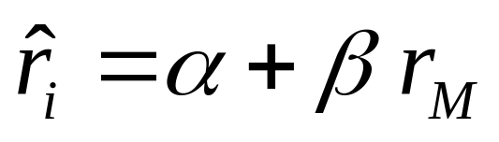
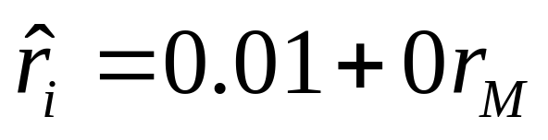
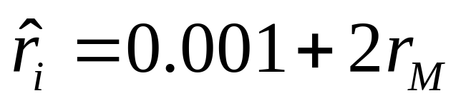
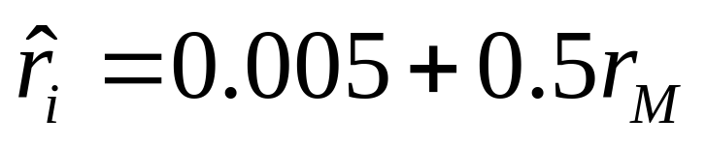
Understanding alpha and beta
Alpha=large and beta=0 implies that your security can guarantee high returns regardless of which direction the market goes
Alpha=small and beta>1 implies that you will profit more than the market average in market upswings, but lose more than the market average in market downturns
Alpha=medium and beta<1 implies that you will not profit as much as the market average in market upswings, but you will not lose as much as the market average in market downturns

